Slide 1
Flight Booking Management system
Python Project​

Slide 2
AGENDA
Introduction​
Primary goals
​Methodology
Working of module
​Summary​

Slide 3
Introduction
The “Flight Ticket Booking Management System” has been developed to override the problems prevailing in the practicing manual system. This software is supported to eliminate and in some cases reduce the hardships faced by this existing system. Moreover, this system is designed for the particular need of the company to carry out operations in a smooth and effective manner.

Slide 4
PRIMARY GOALS
Overview of FTBMS

Slide 5
Every organization, whether big or small, has challenges to overcome and manage the information. this is designed to assist in strategic planning, and will help you ensure that your organization is equipped with the right level of information and details for your future goals.
In this project, we will store all the details of the Passenger. This code allows us to book various available flight tickets, cancel tickets, and check available flights from various cities to cities.

Slide 6
Methodology
This is code work of the Flight Booking Management System without any user interference or front-end and back-end.
This is a code written in Python language, using the concepts of object-oriented and high-level languages.
We used a class named “passenger” to enter the passenger details to reserve a seat.
We have used the concept of iterative conditions the most in our code.
There are a few prerequisites for this project like a basic understanding of python concepts such as file concepts, exception handling, object-oriented programming, and loops.
In case a user enters the wrong data, we are using the exception handling concept to prevent error and data loss.
We imported the module “random” to have a unique ticket number for each passenger.
We have used the concept of modules and created two modules flight and difplane and imported them into our program.

Slide 7
Working of module

Slide 8
Modules
The modules included in our program are:
Random
Flights.py as fy
Difplane.py as pl
Random module is imported to produce a unique number for each ticket.
Flights.py is imported for the display of flights available.
Difplane.py is imported for the display of each flight information.
These modules are used in order to have a clear view on the code.

Slide 9
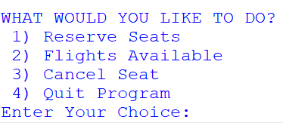
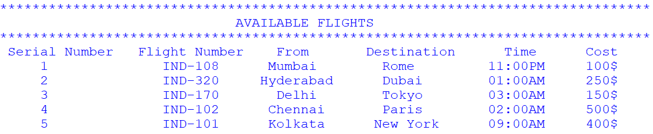
Working of module
First, we display a driver menu every time the user wants to proceed with an operation.
If chosen 1, we ask the user to select the flight and give the details. We generate a unique ticket number using random module. Then we display the details of the passenger’s ticket.
If chosen 2, we display the information of the flights available.
If chosen 3, we ask the user to give all the details of the passenger’s ticket, if given the wrong details, we display Invalid details using the exception handling concept else, we display the cancellation.
If chosen 4, the program then terminates with a thank you note.

Slide 10
MEET OUR TEAM
Group 3
H. Rohitha Aiswarya
K. Dinesh
K. Pranay deep​
Team member 1
Team member 2
Team member 3
Group 3

Slide 11
AREAS OF FOCUS
The purpose of Flight Ticket Booking System
To automate the existing manual system with the help of computerized equipment and full-fledged computer software, fulfilling their requirements, so that their valuable data/information can be stored for a longer period with easy access and manipulation of the same. The required software and hardware are easily available and easy to work with.
Lead to an error-free, secure, reliable, and fast management system. It can assist the user in concentrating on their other activities rather than concentrating on record keeping. Thus, it will help the organization in better utilization of resources. The organization can maintain computerized records without redundant entries.
Aims to design and implementation of the flight ticket booking management system which will provide customers a facility to reserve tickets online without any hassle

Slide 12



Future works
Add database servers for this entire data
Storing log details in the cloud for end-to-end encryption of data
Develop a user interface design.
Give more advanced software for flight management system including more facilities.
Host an online platform to make it accessible worldwide.
Using modules like Tkinter, panda for data handling

Slide 13
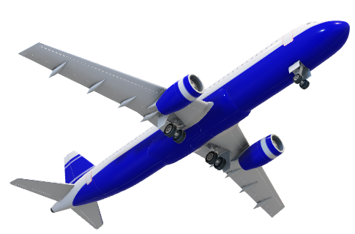
SUMMARY
Before modern computing, the reservation system was done using manual means. This meant that a person about to travel had to spend a lot of unnecessary time waiting in queues in order to book their tickets. The manual process of reservation was also prone to human errors, which lead to a lot of dissatisfaction among travelers.
This Flight Booking Management System has been an attempt to help the user to minimize his workload along with minimizing the paper works and saving time.

Slide 14
THANK YOU
Group 3
Rohitha Aiswarya Hanumanthu AP21110011372
Dinesh Kottakota AP21110011380
Pranay Deep Korada AP21110011383
CSE -T

